Slide 1
The secant method

Slide 2
Introduction
In this topic, we will
Remove the bracketing restriction on the bracketed secant method
We will look at an example and estimate how quickly it converges
Discuss how to best find how quickly the error goes to zero
Look at an implementation

Slide 3
Removing bracketing
Newton’s method simply requires us to have an initial guess
Issue: it requires the derivative
The bracketed secant method does not require the derivative
Issue: it requires us to bracket the root
Issue: the bracketing appears to slow down convergence: O(h)
What if we don’t have a bracket for the root and we don’t have a derivative?

Slide 4
Removing bracketing
Suppose we have a current guess x_{k} and a previous guess x_{k–1}
Could we not just find the root of the interpolating linear polynomial?
f (x)

Slide 5
Removing bracketing
Benefit: We do not require that the root is bracketed
Drawback: Like Newton’s method, this method is not guaranteed to converge
Question: Does this change the rate of convergence?

Slide 6
Example
Find the first root of 2e^{–2x} – e^{–x}
The solution is ln(2)
0 0 1 0.6931
1 0.1 0.7326 0.5931
2 0.374005269572983 0.2586 0.3191 0.5380
3 0.523523434122555 0.1095 0.1696 0.5315
4 0.6333278455599131 0.03272 0.0598 0.3527
5 0.6801164924137422 0.006644 0.01303 0.2178
6 0.6920368309961099 0.0005561 0.001110 0.08521
7 0.6931256976122437 0.00001074 0.00002148 0.01935
8 0.6931471448088051 0.00000001788 0.00000003575 0.001664
9 0.6931471805587934 0.0000000000005759 0.000000000001152 0.00003222
10 0.6.931471805599452 0 0.000000000000000001110 0.00009639

Slide 7
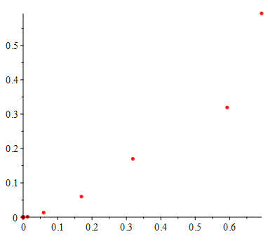
Rate of convergence
How do we estimate the rate of convergence?
If we plot the current error versus the next error, we see a trend

Slide 8
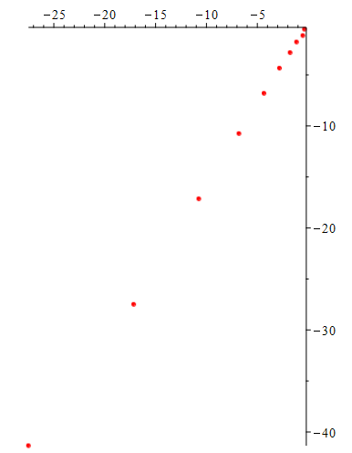
Rate of convergence
How do we estimate the rate of convergence?
If an expression reduces according to h_{k+1} = ah_{k}^{b} then
ln(h_{k+1}) = ln(ah_{k} ^{b}) = ln(a) + b ln(h_{k})
Plot log of the current error versus log of the next error
Beyond the scope of this course:
The secant method is O(h^{φ})
0.02656 + 1.599h
h_{k+1} = 1.027 h_{k}^{1.599}

Slide 9
Implementation
double secant( double f( double x ), double x0, double x1,
double eps_step, double eps_abs,
unsigned int max_iterations ) {
double f0{ f( x0 ) };
double f1{ f( x1 ) };
assert( std::abs( f1 ) > std::abs( f2 ) );
if ( f1 == 0.0 ) {
return x1;
}

Slide 10
Implementation
for ( unsigned int k{0}; k < max_iterations; ++k ) {
double x2{ x1 - f1*(x1 - x0)/(f1 - f0) };
double f2{ f( x2 ) };
if ( f2 == 0.0 ) {
return x2;
}
if ( (std::abs( f2 ) < eps_abs)
&& (std::abs(x2 - x1) < eps_step) ) {
return x2;
}
x0 = x1;
f0 = f1;
x1 = x2;
f1 = f2;
}
}
else {

Slide 11
Implementation
return NAN;
}

Slide 12
Summary
Following this topic, you now
Understand the more generalized secant method
It does not require bracketing the root
Are aware it may not converge, like Newton’s method
Understand that we can deduce the rate of change by plotting a log-log plot and using least-squares best-fitting polynomials
Know that the secant method is O(h^{φ})

Slide 13
References
[1] https://en.wikipedia.org/wiki/Secant_method

Slide 14
Acknowledgments
None so far.

Slide 15
Colophon
These slides were prepared using the Cambria typeface. Mathematical equations use Times New Roman, and source code is presented using Consolas. Mathematical equations are prepared in MathType by Design Science, Inc.
Examples may be formulated and checked using Maple by Maplesoft, Inc.
The photographs of flowers and a monarch butter appearing on the title slide and accenting the top of each other slide were taken at the Royal Botanical Gardens in October of 2017 by Douglas Wilhelm Harder. Please see
https://www.rbg.ca/
for more information.

Slide 16
Disclaimer
These slides are provided for the ece 204 Numerical methods course taught at the University of Waterloo. The material in it reflects the author’s best judgment in light of the information available to them at the time of preparation. Any reliance on these course slides by any party for any other purpose are the responsibility of such parties. The authors accept no responsibility for damages, if any, suffered by any party as a result of decisions made or actions based on these course slides for any other purpose than that for which it was intended.

